Slide 1
YR 2025-26
What happens in a day?

Slide 2
The start of the day
When the bell rings the class teacher will come to meet the children at the gate and welcome you.
The children will come into the classroom and will be helped to put their things away…coat, water bottles, snack pots etc.
There will be a variety of activities available for the children to explore. Help will be given to those children that may need a little longer to settle.

Slide 3
welcome
When the second bell rings the children will come to the carpet area and welcome each other.
The register will be taken and children will select their lunch for the day (with support) ~we will always check all children have a meal selected via the parent app and will help children select an option if it hasn’t been completed at home.
A short teaching input linked to different areas of learning will be given and children will either work in small groups with an adult or more independently to explore their own learning.
The children have daily English and Maths learning opportunities.

Slide 4
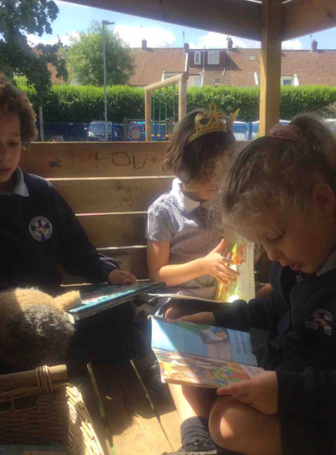
Snack and story
10 am the children stop for a snack and story. This is usually a snack brought in from home and milk provided by school. ~Once children turn 5, if you wish your child to continue drinking milk you will need to pay for this via the Dairy- please ask the office for details.
Story time ~ this helps to develop story language, vocabulary, comprehension skills and a love for reading!
10:15-10:30am PLAY TIME! This will be slightly earlier than the rest of the school to start, to allow the children time to get used to the space and the other reception children.

Slide 5
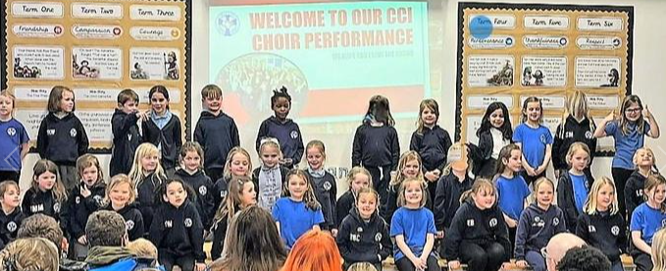
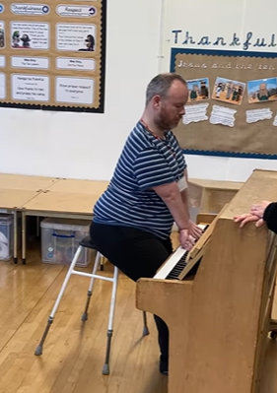
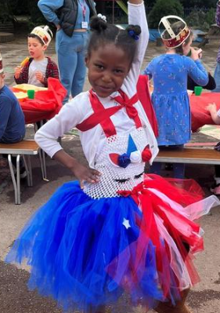
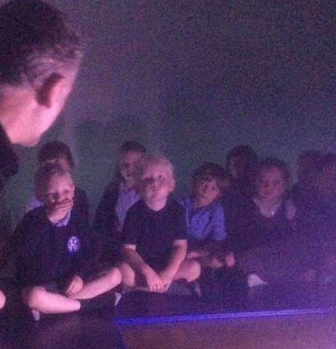
Collective worship 10:30-10:45
When the children are ready, we will join the rest of the school for a daily assembly, where we learn about our school values, share Bible stories, celebrate, sing, learn about inspirational people and the lives of others.

Slide 6
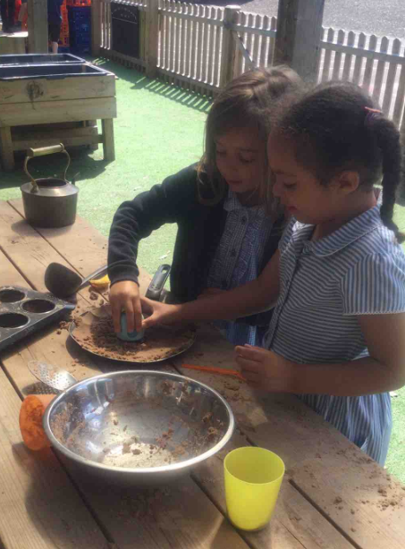
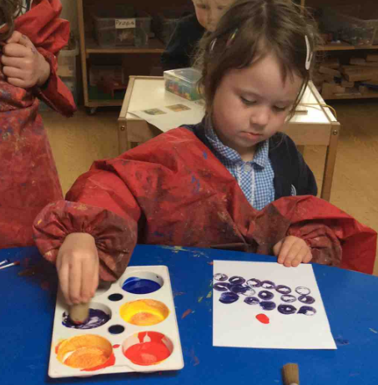
Phonics and continuous provision
10:45-12:10
A daily phonics session is shared with the whole class. We focus on learning new sounds, seeing them in print and using sounds to blend into words for reading and writing.
Adult led group work and independent learning continues throughout the morning.
‘Quick Maths’ is a short, snappy maths session delivered daily to reinforce the maths skills being taught throughout the week

Slide 7
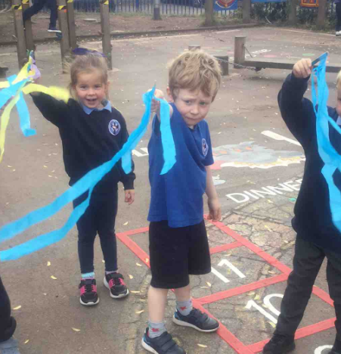
Lunch time
12:10-1.10pm
The children go into the hall for their lunch.
We will support the children to collect their food from Jo and her team when they are having school dinners.
The lunchtime staff are all on hand to help children cut their food or sit with them if they need any help when eating. Should your child not eat very much or not like a particular meal choice, a note will be passed to the class teachers, so we can pass this information on to you.
It’s a great time for the children to chat with their friends and meet other children from different classes.
When the children have finished their lunch, they will be taken outside to play and will be supported by the lunch time staff to interact with others, play games and socialise with friends.

Slide 8
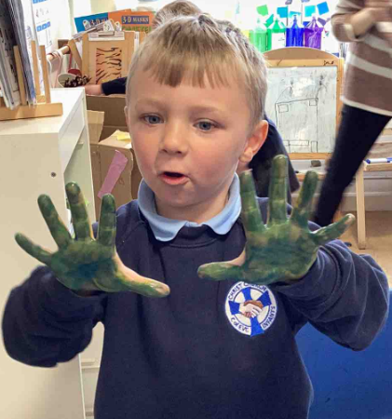
Afternoon
1.10-3.10PM
The children are collected from the playground/field and brought back to the classroom.
The afternoon register is taken and a chance to share lunchtime experiences, discussing games they may have played and new friends they may have met.
A short, adult led input is given and further opportunities for small group work and independent learning.
P.E/Understanding the World/Creative/R.E/P.S.E.D
Mid-afternoon the children stop for a short snack break ~ fruit provided by school. They sometimes have an extra playtime too.

Slide 9
Home time!
Tidy up time. This is a great opportunity to learn routines, work collaboratively and learn how to look after our belongings.
Story time and talking about the successes of the day ~ what have they enjoyed learning or exploring?
The children will leave school from the classroom gate…happy, smiling but no doubt tired and hungry! ☺

