Slide 1
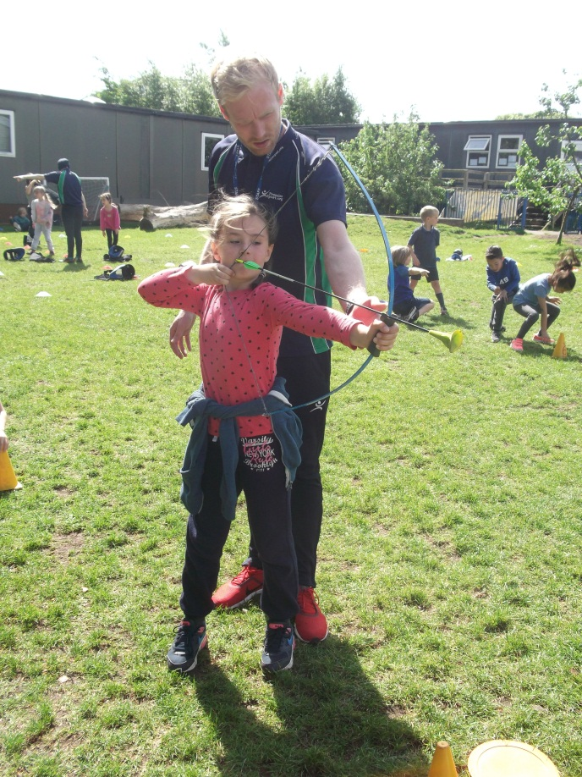
Year 2 Transition Meeting
Wednesday 4th July 2018

Slide 2
Transition
The children know which Year 2 class they are going into and have met their new teachers already.
Children will have a number of opportunities to meet with their new teacher again as well as our very experienced teaching assistants who are moving around this year!
The children will have a summer holiday piece of work to do and bring to show their new teacher on the first day in September.
We will also do some art work in current classes to pass onto new teachers so that the school, while updated by September, will feel familiar to them.

Slide 3
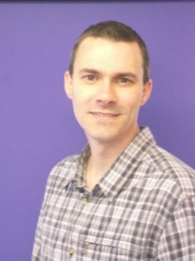
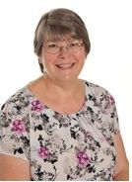
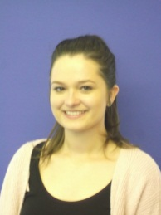
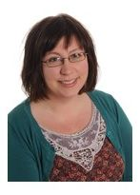
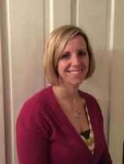
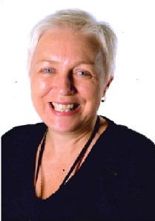
Meet the Year 2 Team
Maple Class – Mr Jones
  & Mrs Doman
Rowan Class – Miss Smith
& Mrs Gardner
Ash Class – Mrs Rylands
& Miss Llewellyn
(split Yr1/2 class)

Slide 4
Year 2 Curriculum
At the beginning of the year 2 we aim to have similar expectation of the children as we have at the end of year 1
The curriculum does step up a gear each year but we gently increase the level of work the children are doing as the year progresses – we don’t have a sudden leap at the beginning of a year.
We will be asking the children to work more independently and for longer periods of time as the year goes on and we find that most children are ready for this challenge.
We will have KS1 Maths and English Curriculum evening on October 9th at 6 pm when we will explain in more depth about the skills children will learning in year 2.

Slide 5
Shhh… SAT’s
We do not talk to the children about SAT’s at all during year 2, while at the same time quietly preparing them for their ‘booklets’.
Please try not to mention them to your children as it can have detrimental affect on their learning.
The SAT’s scores are not the information that we pass to the junior school – we teacher assess children at the end of the year and this is the information that we pass on.

Slide 6
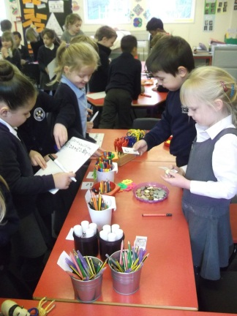
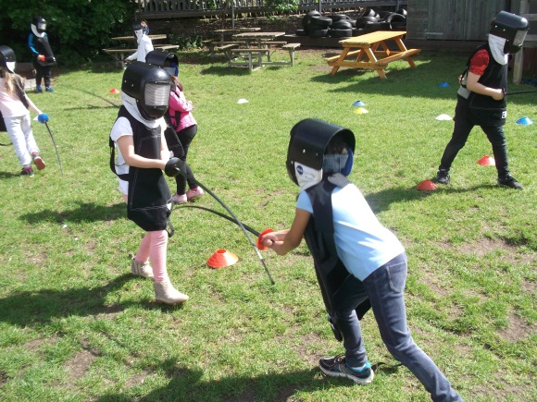
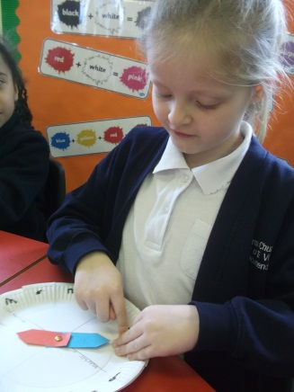
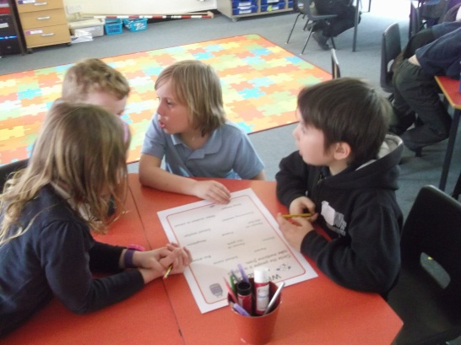
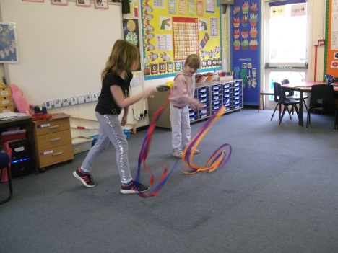
Year 2 is fun!
While we have high expectations of children across the school we also like to make sure that all of our children are having fun!
Year 2 children do still get to play outside, do lots of practical work and experimenting in the same way that the younger children do!

Slide 7

Topics 2018 -2019
Our topic in September will be Pirates across the school.
We will move onto ‘Celebrations’ before Christmas and then ‘Space’ in January.

