Slide 1

Early Years Curriculum evening 2022-2023

Slide 2
AIMS OF THE EVENING
Daily routine and structure of the day
An introduction to Phonics
Writing ~ Expectations and developing an Author
Maths ~ Expectations and developing a Mathematician
Evidence Me ~ Sharing your child’s learning
Exploring the setting ~ Visiting the classroom

Slide 3
A DAY IN THE LIFE OF YOUR CHILD…
Daily Maths, English and phonic session led by an adult with the whole class
Small groups to focus on a supported activity
Independent learning time
Break time, snack and story
Continued group work/ independent learning time
Lunch
PE, Art, PHSE, RE. Opportunities to apply learning skills, language & communication, building relationships and taking observations

Slide 4
INTRODUCTION TO PHONICS
Children develop awareness of different sounds in spoken language from a very early age.
Spoken words are made up of different sounds. They learn to match these sounds to letters.
Phonics is about children knowing how letters link to sounds.
The children then use this when they are reading and writing.

Slide 5
The Importance of Listening Skills
Phonics learning relies on children being able to hear and distinguish the sounds within words.
Children with reduced listening and/or attention skills can struggle with phonics learning.
Listening skills begin at birth and there are lots of things that parents and carers can do to support these skills.
Children are also taught listening and attention skills during their early years education (age 0-5).
The first phase of formal phonics education (Phase 1) also focuses on key listening skills. Without these skills, children may struggle to master the next stage of their phonics learning.

Slide 6

TEACHING PHONICS IN SCHOOL
Children are taught reading and spelling daily throughout the week, and each session will follow a structured format.
The activities used to teach will vary and can be adapted. They are multisensory and appeal to different learning styles. They involve games and individual and group activities as well as teacher-led sessions.
Teachers will assess children’s understanding throughout each session and will also assess knowledge of sounds to see whether a child is ready to move on to the next phase.
Children will also be taught other skills, such as whole-word recognition ‘tricky words’, book skills and a love and enjoyment of reading.

Slide 7

LETTERS & SOUNDS
We use BUG CLUB to support our teaching and learning of letters and sounds
Approved government scheme
Before they start
Tuning into sounds
Listening activities
Oral blending and segmenting
Phase 2
Learn sound and letter correspondences
Start to read and spell simple words

Slide 8


Phoneme: The smallest unit of sound in a word.
a
Grapheme: The letter or letters that represent the phoneme.
or
Digraph: two letters that make the same sound.
igh
trigraph: three letters that make the same sound.

Slide 9
SEE IT, SAY IT
Blending to read
Putting the sounds together to read words
Sound buttons
Pot
mat
. . .
. . .

Slide 10

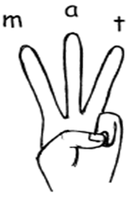
COUNT ON FINGERS
Segmenting to spell
Splitting the word up into individual sounds
f-r-o-g
frog

Slide 11
TRICKY WORDS
Words that cannot be sounded out.
Tricky words in red
the
I
go
no

Slide 12
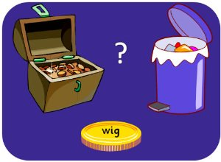
NONSENSE WORDS
Teaching to decode using phonic knowledge
Buried treasure
gef
laip

Slide 13




How we build a reader
Take time to read aloud- children who are read to, ‘read’. It exposes children to language that is different to everyday conversations
Find a quiet time - daily practise where possible!
Repetition – Key words/ Tricky words
Enjoy it, make it fun! Play with sounds/ words
Say it, clap it, stamp it
Rhyme and songs
Starting sounds
a for
b for

Slide 14

WRITING
EARLY LEARNING GOAL
Write recognisable letters, most of which are correctly formed.
Spell words by identifying sounds in them and representing the sounds with a letter or letters.
Write simple phrases and sentences that can be read by others.

Slide 15
Gross motor skills
Crawling through tunnels
Balance beams
Carrying buckets of sand or water
Swinging on monkey bars
Digging in the sand or soil
Yoga and dance sessions
Tug of war (carefully supervised!).

Slide 16
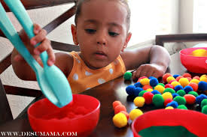
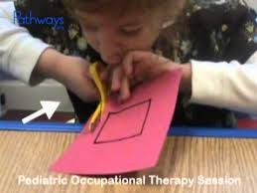
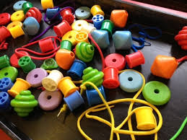
Fine Motor skills
Fine motor control is required to hold and manipulate a writing tool.
Doing up and undoing buttons and zips
Threading beads
Using tweezers and chopsticks
Building towers
Turning keys in locks
Playing with peg boards
Colouring in between the lines on a picture
Icing biscuits
Cutting or tearing paper around an outline.

Slide 17
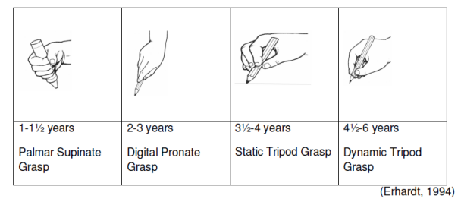
Developing a functional tripod pencil grip
The development of a functional pencil grip depends on the stage of hand dominance and hand grasp development. Even when a child has good fine motor skills and well-developed grasp patterns, holding a pencil is a new and complex task.

Slide 18

Pre-writing skills
Children should be able to draw the following shapes which are components of letters of the alphabet before they are ready to start letter formation:

Slide 19
How we build an author
CREATIVITY
Talk for Writing
Oracy
Love of literature – range of genres
Purposeful role play
Wide Vocabulary
Engaging experiences
PROCESS
Sound knowledge
Mark making/ letter formation
Segmenting/robot arms/chop it up
Blending/Reading
CVC words – (mat, tin, pat)
Captions (it is a cat)
Capital letters, full stops, finger spaces

Slide 20
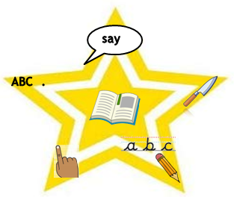
A writing classroom
For storytelling: Costumes, Hats, Toys, Puppets, Masks
Writing Area: Envelopes and post box, Small booklets, Materials for practising handwriting, paper, pencils, mini whiteboards, story maps, Message Centre
Post box
Tools - Spelling cards & sound mats, finger spaces, talking tins
Book corners – class stories
Role Play area with resources

Slide 21
How Can you help?
Little and often! Home learning sheets and practise name writing
Fun and creative ideas - https://fiveminutemum.com/games-and-activities/play/phonics
Pencil grip reminders.
Experiences – Christmas/Birthday cards, Thank you notes, Letters, Postcards

Slide 22
BEING A MATHEMATICIAN
ELG: Number
• have a deep understanding of number to 10, including the composition of each number;
• Subitise (recognise quantities without counting) up to 5;
• Automatically recall (without reference to rhymes, counting or other aids) number bonds up to 5 (including subtraction facts) and some number bonds to 10, including double facts.
ELG: Numerical Patterns
• Verbally count beyond 20, recognising the pattern of the counting system; -
• Compare quantities up to 10 in different contexts, recognising when one quantity is greater than, less than or the same as the other quantity;
• Explore and represent patterns within numbers up to 10, including evens and odds, double facts and how quantities can be distributed equally.

Slide 23
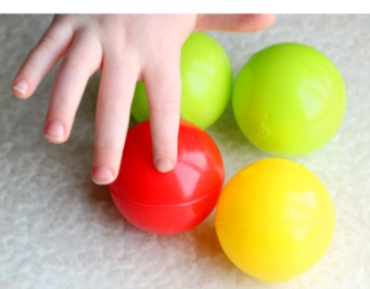

COUNTING
1. Count everything once
2. Say the numbers in the right order
3. The last number you say is how many there are

Slide 24
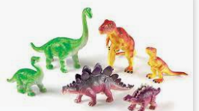
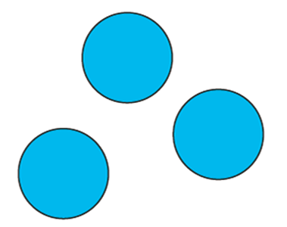


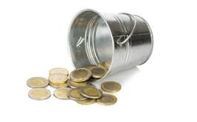
COUNTING PROGRESSION

Slide 25


SUBITISING
The ability to look at a small number of objects and instantly recognise how many there are without needing to count.
WHY? –Less reliance on counting, less overloaded= make mathematical links (addition/subtraction)
Fast eyes ready…

Slide 26


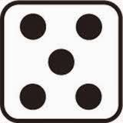
SUBITISING PROGRESSION

Slide 27
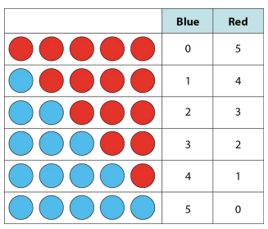

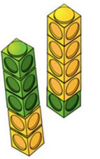

COMPOSITION
That numbers can be made up of other numbers.
Looking for and noticing patterns helps children understand mathematical relationships.

Slide 28

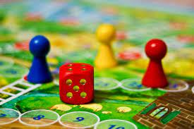
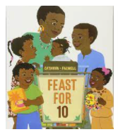

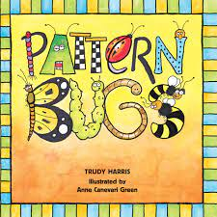
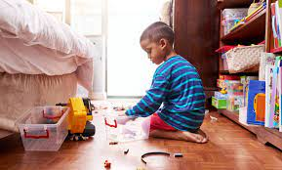
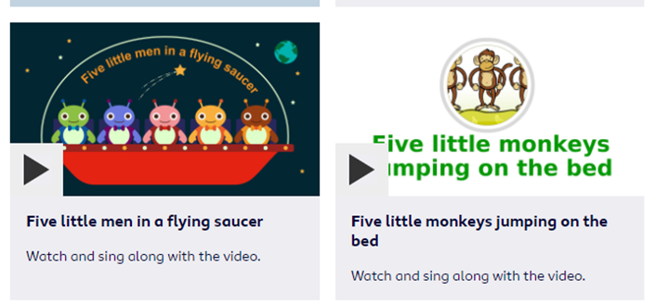
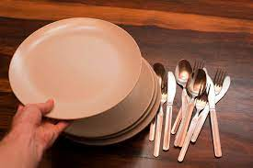
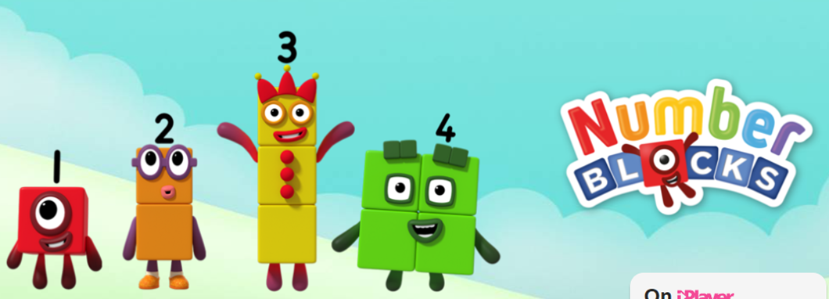
HOW WE BUILD A MATHEMATICIAN

Slide 29

EVIDENCE ME
Password request
will be sent out this week
(Check your junk email)
Termly updates – last week of term
Includes 5 – 10 observations
Parents can join in and share observations – see additional handouts for how to.

Slide 30

Please visit the classrooms to see examples of the different areas of learning and some of the activities.
Feel free to ask questions and speak to the class teachers if we can support you/ your children further.
Individual progress will be discussed during the Parent/ Carer meetings next term.

