Slide 1
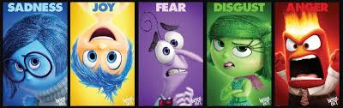
Emotion Coaching

Slide 2
What is it?
Emotion coaching is about helping children to become more aware of their emotions and to manage their own feelings particularly during instances of misbehaviour. It entails validating children's emotions, setting limits where appropriate and problem-solving with the child to develop more effective behavioural strategies.
In effect, emotion coaching techniques help children to learn to:
Self-regulate their emotions and behaviour.
It enables us to create an ethos of positive learning behaviour and to have the confidence to de-escalate situations when behaviour is challenging.
Emotion coaching provides a longer-term solutions to children's well-being and resilience.

Slide 3

Regulation and Resilience
We are not born able to regulate
Emotional regulation is learned
Well-regulated adults are needed when children/young people experience dysregulation
The brain is shaped by social experience and strengthened by repetition
Notes:
Also…relate to babies and mirroring (video!) and how this can help them to develop empathy powerful for connections
Plasticity never too late to start!

Slide 4
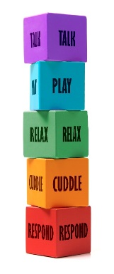

Interpersonal Connection: Five to Thrive for life
This sequence can happen in the blink of an eye
The five key activities which actively maintain brain function through mindful co-regulation and co-learning
Responding and assessing needs
  Five to Thrive key word: RESPOND
Connecting and engaging
  Five to Thrive key word: ENGAGE
Self-regulating stress
  Five to Thrive key word: RELAX
Being playful: activating the right brain
  Five to Thrive key word: PLAY
Creating a narrative: activating the left brain
  Five to Thrive key word: TALK

Slide 5
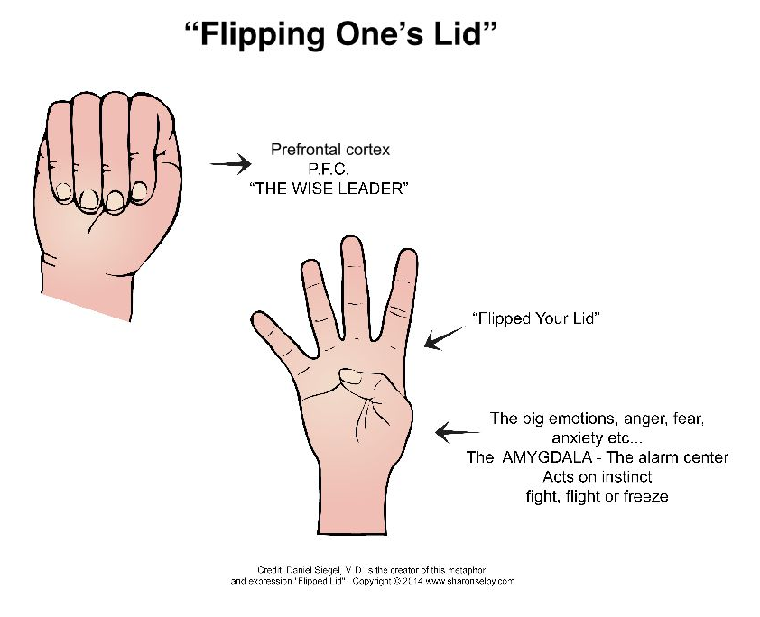

What happens when children dysregulate?
Use your hands to imagine your brain
The alarm centre!
Big boss Bootsy!

Slide 6
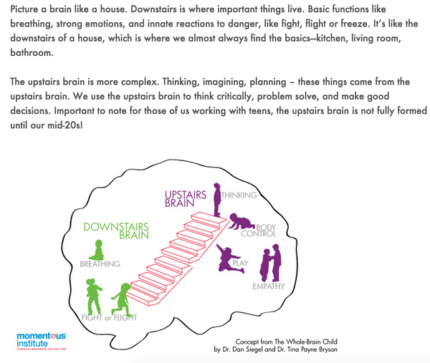
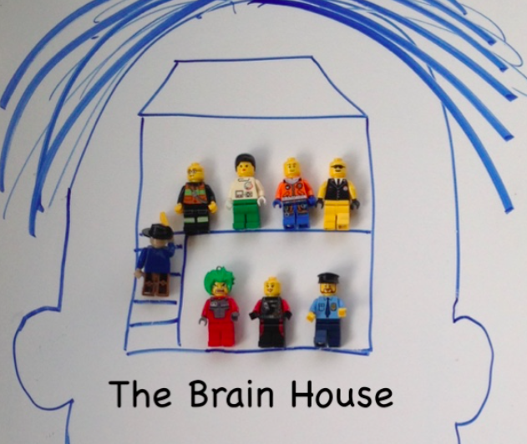
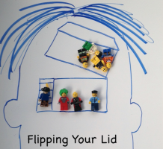
Notes:
Refer to emotion coaching day with children

Slide 7
If we flip our lid…
… the downstairs brain
- rapid response
Fight
  Remove the threat
Flight
  Remove self!
Freeze
  Regress to attract adult help e.g.
  Immobility, big eyes, smiles, perhaps incontinence
… and the upstairs brain
- strategies and behaviours
Aggression
  Safety through dominance
Absence
  Safety through concealment
Appeasement
  Safety through manipulation
…SURVIVING NOT THRIVING

Slide 8
Putting the lid back on
Escalation
High stress levels…
  adrenaline, cortisol, etc.
  rising blood pressure
  shallow breathing
  Clenched muscles
The downstairs brain is in charge
De-escalation
Relax (good vagal tone)
  oxytocin, dopamine, etc.
  lowering blood pressure
  deeper breathing
  reduced muscle tension
The upstairs brain is back in action
SURVIVAL
SAFETY
Notes:
Out of survival mode…
Not just anger….fear, sadness…

Slide 9
Emotion coaching is good for children and young people
Are more emotionally stable
Achieve more
Are more popular
Gottman's research showed that emotion coached children:
Are more resilient
Have fewer infectious illnesses
Have fewer behavioural problems
Notes:
Refer to vagus nerve image
Vagus nerve runs from brain through the whole body and acts on all organs-vital to be regulated to learn and respond well. Good vagal tone

Slide 10


Self-regulation and Resilience
Emotion coaching promotes healthy brain development while dealing with behaviour in the moment.
It provides a description to connect feelings, thinking and behaving.
Rewards and sanctions provides:
External frameworks and regulation
Emotion Coaching provides:
Internal frameworks and regulation
Notes:
Talk about improved brain connections and how the brain can learn to change and adapt.
This is something we are addressing as a school a bit further from Sept…

Slide 11
Emotion coaching involves…
… a practical 3 step approach to dealing with behaviour in the moment
Step 1
  Recognising, empathising, validating the feelings and labelling them (it’s ok to feel…)
Step 2
  Setting limits on behaviour (as well as getting child’s narrative) where appropriate
Step 3
  Problem-solving with the child or young person

Slide 12
Disapproving Style
Negative emotions are weak and show lack of control; the child needs to ‘toughen up’
Lacks empathy and instead, is critical and/or intolerant
Believes that negative emotions are used to manipulate
Feels the need to control and regain power
Notices the behaviour but not the emotions
Uses punishment or discipline to get rid of emotions
Notes:
Different ways to respond to emotions…

Slide 13
Dismissing Style
Wants the child/ young person to feel better but is uncomfortable with negative emotions
Sees negative emotions as ‘toxic’ and to be ‘got over’ quickly
Believes paying attention to emotions makes them worse
Reduces or minimizes the emotional experience: “You’ll be fine”, “It’s not a big deal”.
Motivated by the need to rescue/make things better: “I’ll buy you a new one!”
Uses logic or distraction to get rid of the emotion: “Have a biscuit!”
Notes:
None of this is criticism…we are all guilty of many of these with best intentions!

Slide 14
Disapproving and dismissing may seem to work, but the actual message is …
  Can lead to hiding of emotions, less (or no) self-regulation, reliance on distraction to get rid of emotion
  Generates more negative feelings – resentment, guilt, shame, anger
“What you are feeling is not right, your assessment of the situation is wrong, you must not feel this way”
  They are not given opportunities to experience emotions and deal with them effectively, so grow up unprepared for life’s challenges
  The child does not learn to trust their own feelings, which affects their ability to make decisions
  They do not have opportunities to self-regulate or problem-solve
Notes:
When thinking about disapproving/dismissing we see that it works therefore it must be good but actually…

Slide 15


Laissez faire style
Occurs when the adult is overwhelmed by the power of the emotions driving the child: there are two flipped lids…
  The adult feels helpless, afraid or distressed
  Despite the empathy of the adult, the child experiences no safe containment of their emotions
  The child receives no guidance on how to manage the feelings
Once the adult is in laissez faire, the behaviour will escalate
Notes:
We’ve all done this!

Slide 16
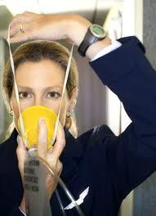
How do we do emotion coaching?
Having emotional awareness of own emotions (meta-emotion philosophy)
“Put on your oxygen mask first before putting it on the child”
Recognising the power and purpose of emotions
Empathising
Active listening / relationship building
Problem solving
Role-modelling
Notes:
I’ve often role modelled getting it wrong and then explaining this after I have calmed down!

Slide 17

Emotion coaching style: high empathy / high guidance
Three steps to success:
Step 1
  Recognising, empathising, validating the feelings and labelling them
  ‘Connection before correction’ (Golding et al, 2013)
Step 2
  Setting limits on behaviour (as well as getting child’s narrative)
  Rapport before reason
  All feelings are ok but not all behaviours are ok!
Step 3
  Problem-solving with the child or young person

Slide 18
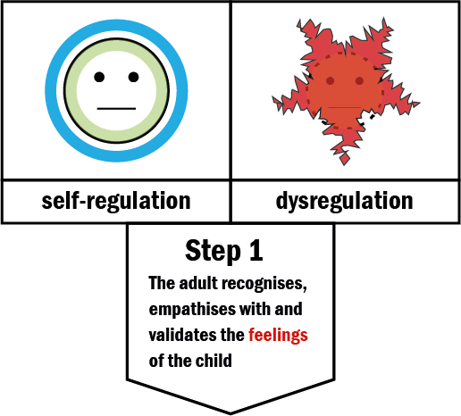
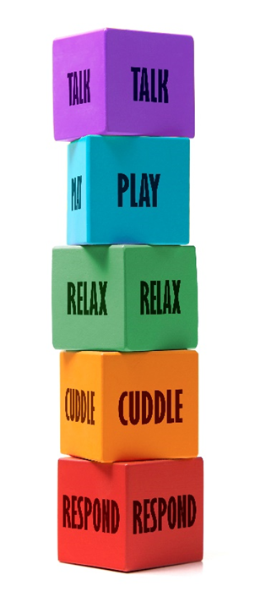
FTT
RESPOND
And
ENGAGE

Slide 19
Step 1: Empathise, validate and label
Child wants sweets at the shops and gets angry when you says no
This is ok and normal
Try to see it from their point of view.
Recognise the emotion
Use words to reflect the child’s emotion; help them label it.
I can see that you feel angry…
Talk it through
Next time you feel like this do you think you could try to….
It’s ok to be disappointed it’s not ok to…
Show you understand this emotion, they aren’t alone. Calm them
It’s disappointing/tricky but…
Notes:
You need to show and express that you get it. Saying your are angry that you couldn’t have sweets this time…. I get that…. Or I’m sorry you feel angry…

Slide 20

Co-regulation
Establish relationship
Get on a level with the child or young person
The adult should set the emotional tone: NOT the adult reflecting back the angry or distressed face of the child, but the child being able to reflect the calm and empathic face of the adult
Notes:
In the moment….

Slide 21
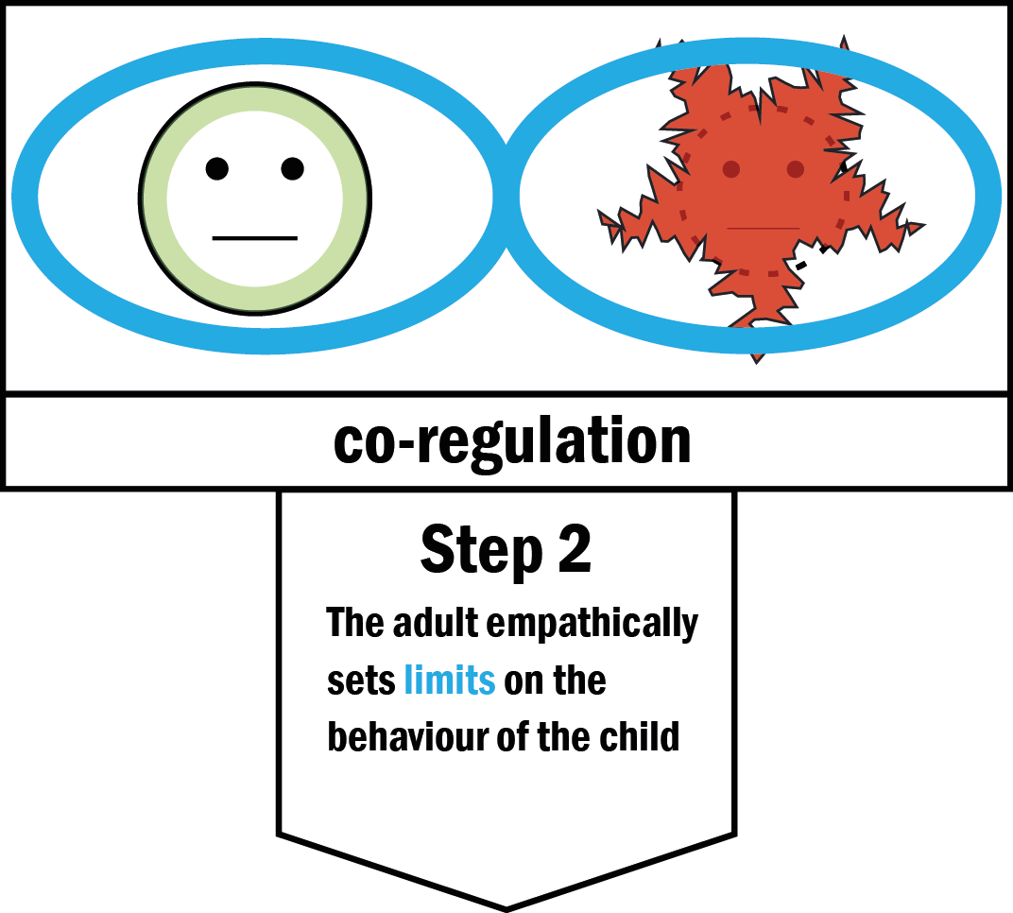
FTT
RELAX

Slide 22
Step 2: Set limits
Co-regulation comes first.
The adult’s relaxation places boundaries around the child’s energy – emotional mirroring allows the child to relax and share the adult’s emotions…
…then teaching / co-learning can occur
State the boundary limits of acceptable behaviour.
Make it clear that some behaviours cannot be accepted but don’t shame/embarrass the child
“We need to keep everyone safe…”
“It’s not ok to hit people.”

Slide 23
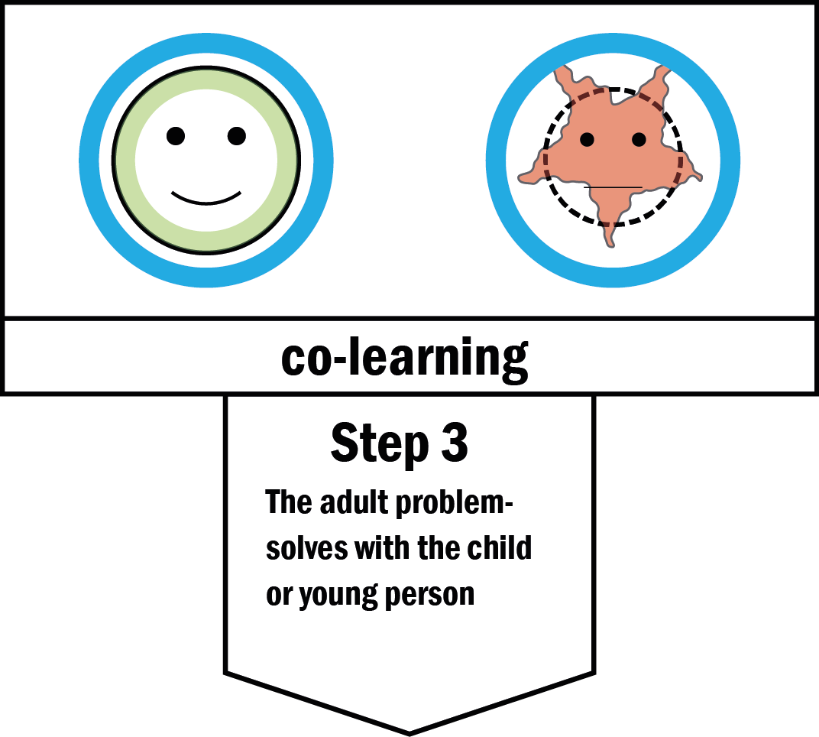

FTT
PLAY
and
TALK

Slide 24
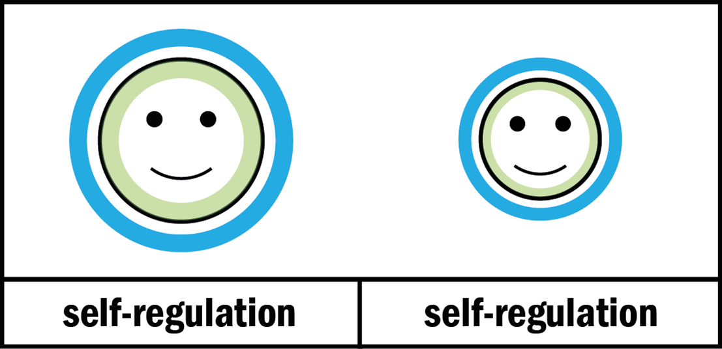
Step 3: Problem-solve with the child
Let’s try this… if you feel like that again…
Next time….
Could you try….

Slide 25
Emotion coaching builds...
… trusting and respectful relationships with children and young people
The adult trusts and respects the child
  Engaging emotionally can feel risky, but without co-regulation the child can't develop self-regulation
The child trusts and respects the adult
  Emotional mirroring is more powerful even than the fear felt by vulnerable and traumatised children
… healthy brains: science suggests this promotes good vagal tone and develops powerful brain connections

Slide 26
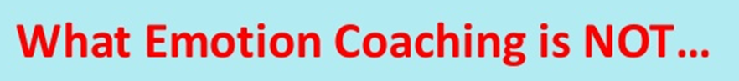

… good for the school
Emotion coaching is an evidence and relationship-based approach to dealing with behaviour in the moment that sets every intervention in the context of a respectful relationship

